Slide 1


Employee Data Analysis & Model Training
A presentation on feature selection, model training, and evaluation. Prepared for data scientists and machine learning engineers.
by Sangram Sonawane

Slide 2
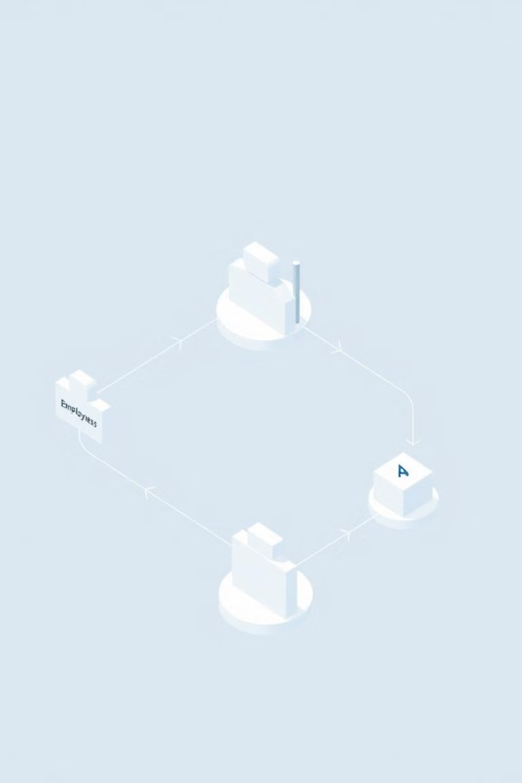
Project Overview
This project analyzes employee data to predict key outcomes. Feature selection is crucial for model accuracy.
1
Data Analysis
Analyzing employee datasets to find patterns and insights.
2
Feature Selection
Selecting key features for accurate prediction modeling.
3
Model Training
Training a machine learning model for future predictions.
4
Model Evaluation
Evaluating model performance for continuous improvement.

Slide 3
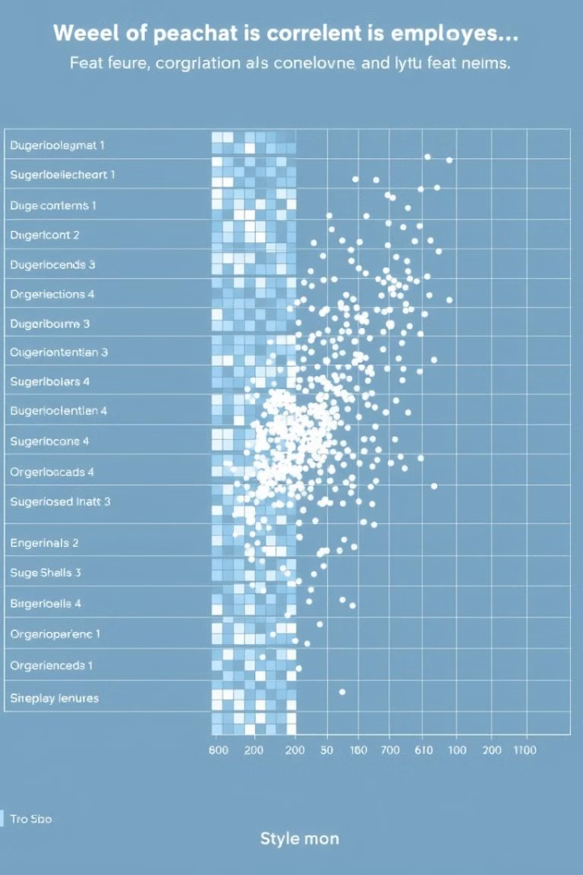


Feature Selection
Key features affecting the target variable were identified. We used correlation analysis and feature importance methods.
Key Features
Correlation Analysis
Feature Importance
Identify main inputs to affect outputs.
Understand feature relationships.
Identify the most important predictors.

Slide 4
Model Training
The data was split into training and testing sets. Numerical features were standardized using StandardScaler.
Data Splitting
Feature Scaling
Model Training
Dividing data for training and validation.
Using StandardScaler for numerical features.
Training with Random Forest or Logistic Regression.

Slide 5
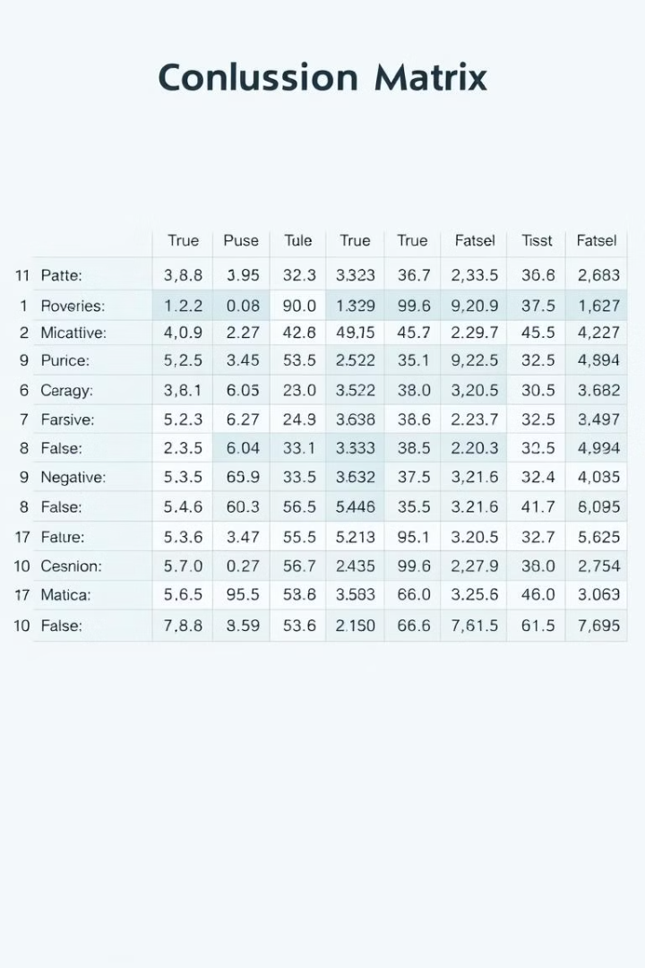
Model Evaluation
Model performance was evaluated using several metrics. We considered accuracy, precision, recall, and F1-score.
Accuracy
Overall correctness of the model.
Precision
Ability to avoid false positives.
Recall
Ability to find all relevant cases.
F1-Score
Harmonic mean of precision and recall.

Slide 6





Deliverables
The project deliverables include several key components. These files are essential for replicating and validating the results.
Google Colab
Notebook with all code.
Trained Model
employee_model.pkl
Scaler
scaler.pkl
Dataset
employee_data.csv

Slide 7

GitHub Submission
All project files are uploaded to GitHub repository. Ensure all files are included for complete evaluation.
1
Upload Files
Notebook, data, model, scaler.
2
Repository Link
Share link for review.
3
Evaluation
Assess results.

